Slide 1

Bank Customer Deposit
Prediction
Analyzing Customer Behavior for Better Deposit Management
Project by AKSHAY VP
Data Scientist
19-2-2026

Slide 2
INTRODUCTION
Objective: Analyze customer data to understand deposit behavior.
Importance: Helps banks target customers effectively and increase deposit subscriptions.
Dataset: Bank marketing dataset with 50,000 records and 17 features.

Slide 3
PROBLEM UNDERSTANDING
Goal: Predict if a customer will subscribe to a deposit.
Business Objective: Target customers effectively and increase deposit subscriptions.

Slide 4
DATASET OVERVIEW
Number of rows: 50,000+
Number of columns: 17
Features include:
Demographics: age, job, marital, education
Financial: balance, housing loan
Campaign info: contact, day, month, campaign, P days, previous, P outcome
Target: deposit

Slide 5
EXPLORATORY DATA ANALYSIS (EDA)
Age distribution of customers
Job vs Deposit (which jobs subscribe more)
Categorical Variable Analysis
Balance vs Deposit
Outlier Analysis: Identified extreme values in the balance feature using boxplots to understand their impact.

Slide 6
DATA PREPROCESSING
Missing values: Handled if any
Encoding :
Label Encoding applied to categorical columns (job, marital, education, contact, poutcome)
Feature Removal: Dropped the duration column to prevent data leakage, as call duration is known only after the marketing call.
Train-Test Split: 80% training, 20% testing

Slide 7
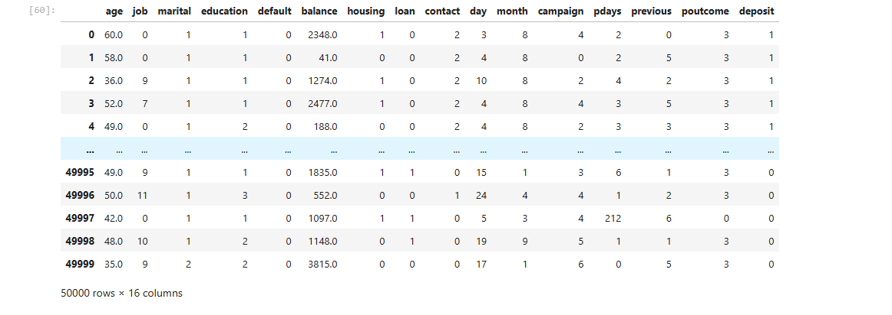
DATA TABLE

Slide 8
Techniques Used
Descriptive Statistics
Mean, median, count, and distribution analysis
Data Visualization
Count Plots, Box Plots, Heatmaps
Modeling – Classification Models
Logistic Regression, Decision Tree, Random Forest, K-Nearest Neighbors , Support Vector Machine , Naïve Bayes, Gradient Boosting, XGBoost

Slide 9
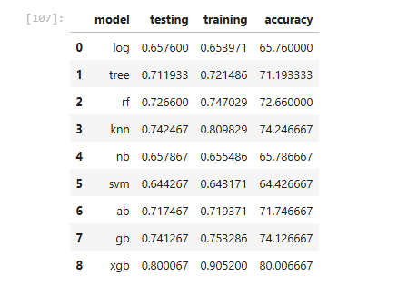

Slide 10
BEST PERFORMING MODEL: XGBOOST
Model Performance
Accuracy: 80%
Precision: 0.77
Recall: 0.82
F1-Score: 0.80
XGBoost achieved 80% testing accuracy with balanced precision and recall, making it the best model for predicting customer deposits.

Slide 11
BEST PERFORMING MODEL: XGBOOST​
Performed Hyperparameter Tuning to improve model performance and find the optimal parameter combination.
Best performing model: XGBoost (Extreme Gradient Boosting)
Achieved Best Score: 83% accuracy after tuning.

Slide 12
KEY INSIGHTS
Customer account balance has a strong influence on deposit subscription.
Previous campaign response impacts future deposit decisions.
Certain job and marital categories show higher subscription rates.
Deposit decisions depend on multiple customer factors combined.

Slide 13
TOOLS & TECHNOLOGIES
Python: pandas, NumPy, scikit-learn, XGBoost, matplotlib, seaborn
Jupyter Notebook: Analysis and modeling
PowerPoint / Canva: Presentation

Slide 14
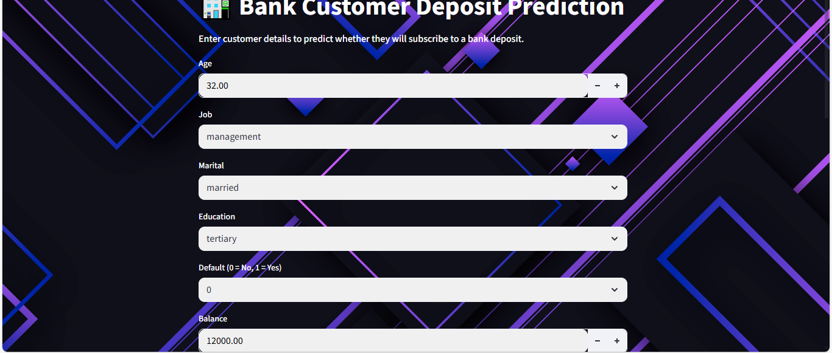
Model Deployment using Streamlit

Slide 15
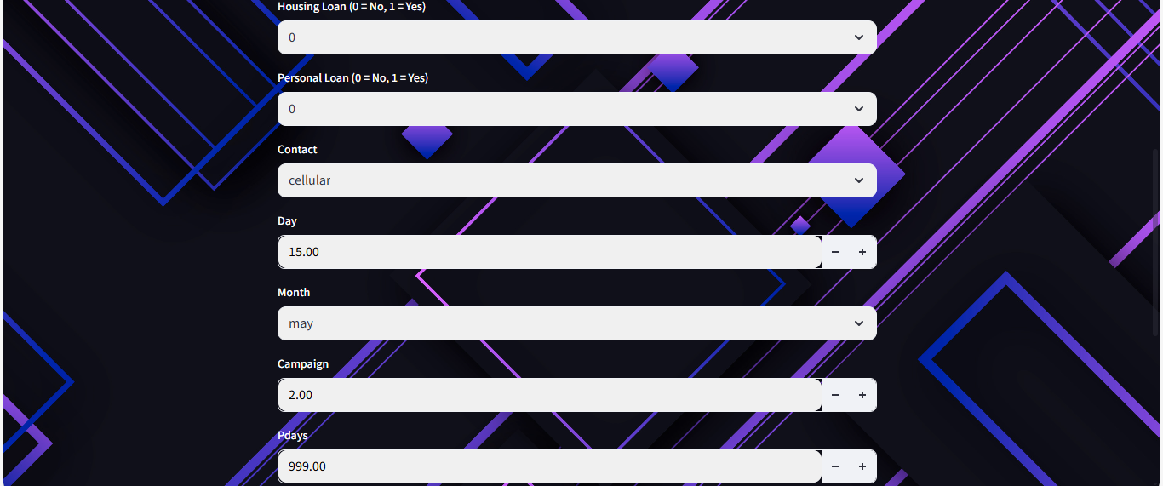

Slide 16
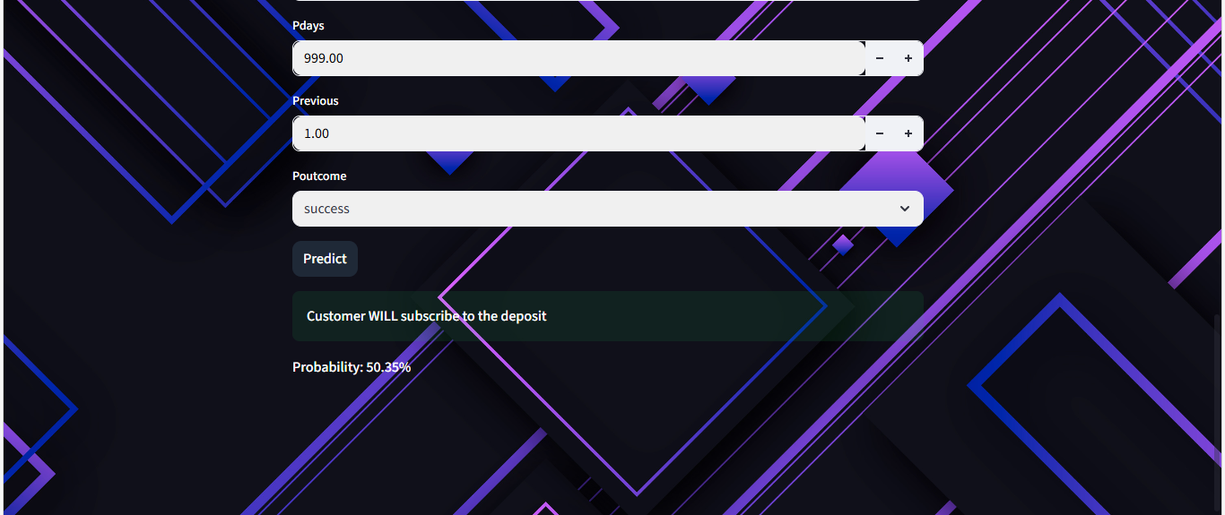

Slide 17
THANK YOU
9048321618
akshayvp5001@gmail.com

